Slide 1
Seminar 4
Maksym Shevchenko, AI-1

Slide 2
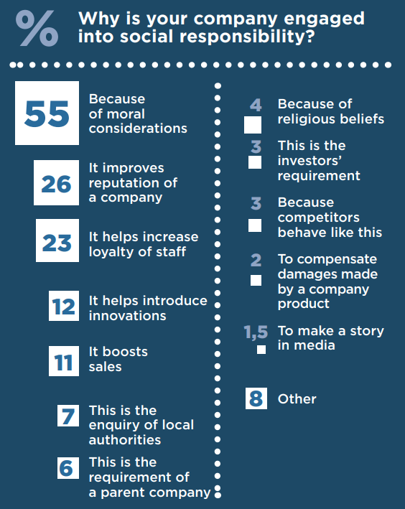
What is historic and cultural background for CSR practices in Ukraine?
Notes:
The idea of ​​corporate social responsibility came to fruition several decades ago when UN Secretary-General Kofi Anon called on the leaders of the world's largest companies to join an international initiative, the Global Compact, to create a business partnership. UN, trade unions, non-governmental organizations to implement the general principles of social equality and environmental protection. Building on the benefits of joint action, the Global Compact has set itself the task of developing the principles of corporate social responsibility and ensuring its participation in solving the most pressing problems of globalization. Thus, private business, joining the agreement in cooperation with other social partners, will be able to promote the idea of ​​forming a sustainable and open global economy. CSR in Ukraine is in its infancy. The most active in this area are, first of all, representative offices of foreign companies that transfer modern world practices, principles and standards to Ukraine, as well as large and small domestic enterprises and organizations that improve their activities based on the concepts of Total Quality Management. However, this process requires some coordination and encouragement, and therefore the active participation of the state, which should identify CSR as a desirable behavior for business and develop a set of appropriate incentives (this has already reached the public authorities of EU member states).At the same time, it is necessary to realize that CSR is directly related to the level of business excellence of enterprises, organizations and institutions. After all, if they are not perfect, they are unlikely to be able to systematically and for a long time to meet the needs of all stakeholders. This is extremely important to consider in Ukraine, where the level of business excellence of more organizations is significantly lower than the corresponding level in more developed countries. That is why state support in Ukraine is necessary both to emphasize the importance of ethical and socially responsible behavior of companies, to promote the best practices of domestic social responsibility companies in Ukraine and abroad, and to increase the prestige of perfect organizations and processes of continuous systemic improvement. This will allow most companies to strengthen their long-term competitiveness and reputation through practices of responsible treatment of their employees, consumers and other stakeholders.

Slide 3
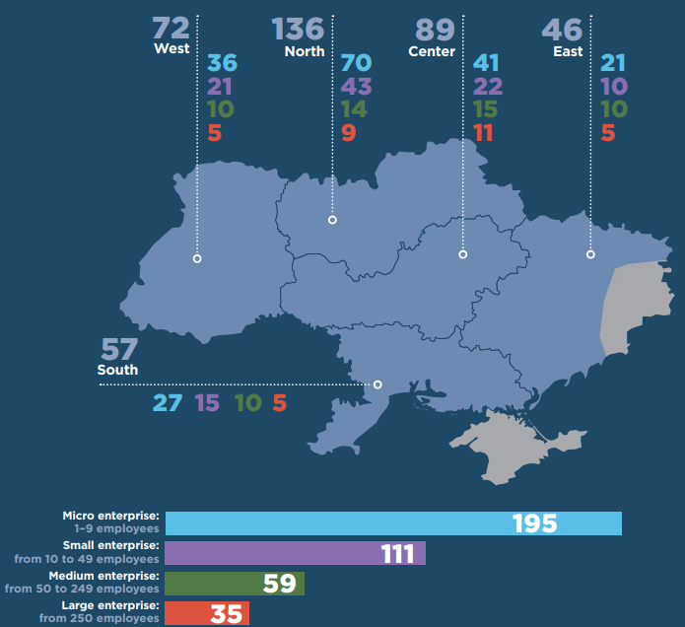
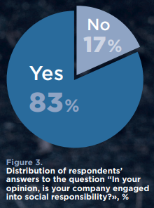
What is the current state of affairs in the field of CSR?

Slide 4
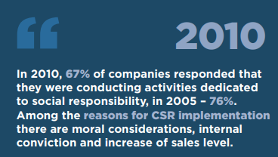
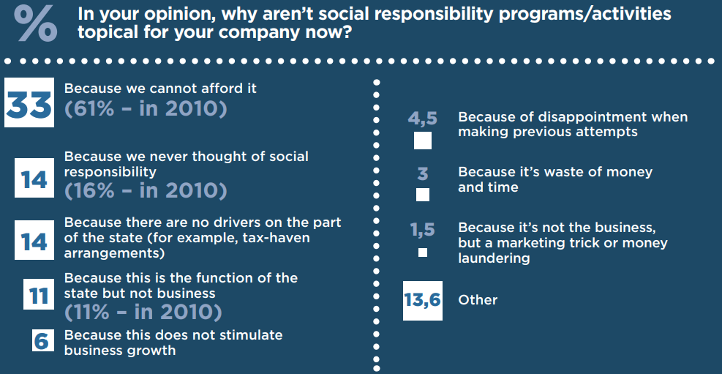
Retrospective
Notes:
As one can see on the figure 4, impact of external factors (like requirements of a parent company and investors, enquiries from local self-governance authorities, experience of competitors) on CSR implementation is the lowest. Those who do not implement the social responsibility policy consider that their company cannot afford it. In fact, for many companies their financial difficulties are extremely topical, though, we consider that a great role is also played by a stereotype that the CSR policy requires a lot of funds.
Among the other most widespread reasons of nonimplementation of CSR – companies never thought of social responsibility, absence of drivers on the part of the state, belief that CSR is the function of the state, but not business (see figure 5). We consider, that distribution of answers to this question may suggest that representatives of the Ukrainian companies are poorly aware of the core essence and advantages of CSR implementation.

Slide 5
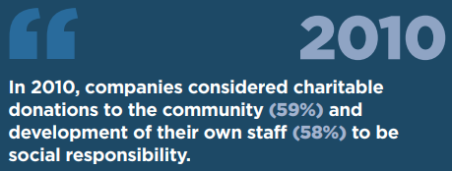
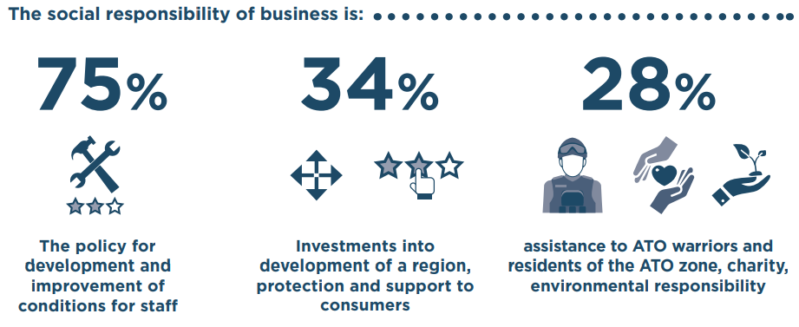
What is CSR for Ukrainian companies?
Notes:
The majority of respondents (75%) understand social responsibility as a policy of growth and improvement of working conditions for employees. One third of the interviewed consider it to be investments into development of a region as well as protection and support to consumers. A bit more than one fourth of the interviewed refer assistance to ATO warriors and residents of the ATO zone as well as charitable donations and environmental protection to CSR (fi gure 6). The smallest number of Ukrainian companies consider social responsibility to be fight against corruption and assistance to internally displaced persons.
For the majority of public companies, social responsibility of business is development and improvement of working conditions for staff and investments into development of a region. It is no less important to implement environmental projects, protect and support consumers and provide assistance to ATO warriors and residents of the ATO zone.
For the majority of private companies, it is a policy of growth and improvement of working conditions for staff. One third of them consider it to be protection and support to consumers and investments into development of a region

Slide 6
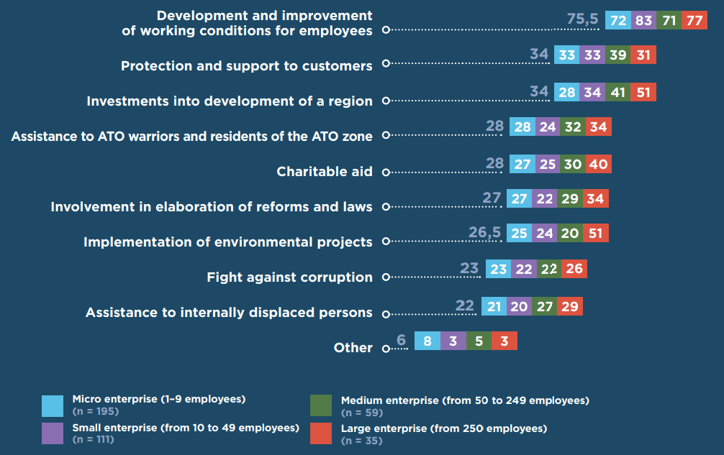
What is CSR for Ukrainian companies?

Slide 7
Are the CSR initiatives necessary in Ukraine?
YES
, but at will

Slide 8
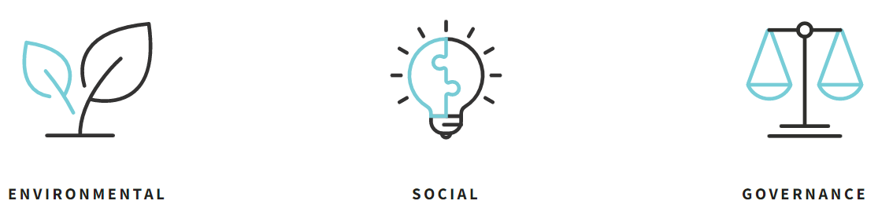
Are there CSR initiatives/ practices in sphere of your professional activity?
Notes:
See next slide for details

Slide 9

Choose one of the non-financial reports…
Notes:
https://www.epam.com/about/who-we-are/corporate-responsibility
https://www.epam.com/content/dam/epam/company/csr/corporate-responsibility/EPAM_ESG_Fast_Facts_Brochure.pdf

